Slide 1

Spotify Music Analytics
Information Visualization - 2025/2026
24/11/2025
João Sousa - 103415 (40% of the work done)
António Alberto - 114622 (60% of the work done)
https://spotify-songs-analytics.github.io/spotify-songs-analytics/

Slide 2


Dataset
Source
Variables
Three Public Spotify datasets from Kaggle, combined
2300+ songs (2000-2023)
800+ artists
20+ genres
Acousticness: level of acoustic instruments vs. electronic (0-1)
Danceability: suitability for dancing (0-1)
Energy: perceived intensity and activity (0-1)
Valence: positivity/happiness conveyed (0-1)
Speechiness: how much a track sounds like spoken words (0-1)
Metadata
Popularity (0–100, based on engagement)
Release Year
Genre
Artists
2

Slide 3

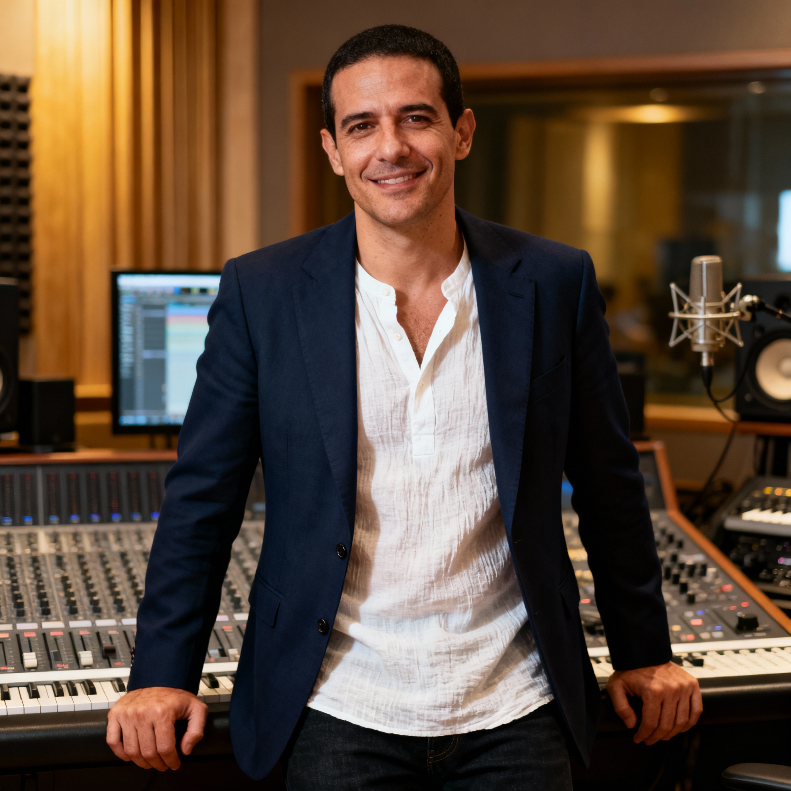
Personas
Sofia Almeida
Miguel Santos
24 years old, Music student at UA, wants to investigate trends in musical genres for her master's thesis on the evolution of Hip-Hop. She needs to identify patterns across decades (2000–2023) visually, without spending hours in Excel.
35 years old, music producer who needs to identify sound trends to guide production of new music. He wants to know which attributes (energy, danceability, valence) are growing and how to compare his artist's profile with successful artists of the same genre.
3

Slide 4
Main Questions
How do energy and danceability correlate with song popularity?
How do the audio characteristics of a specific artist evolve across their discography?
How have the overall audio characteristics changed over decades?
What are the distinct audio characteristic profiles for different artists?
Are songs becoming more energetic and danceable?
How have the different genres evolved from 2000 to 2023?
Miguel Santos
Sofia Almeida
4

Slide 5
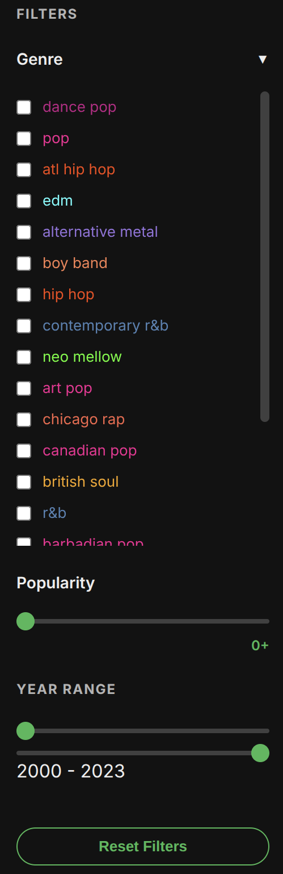
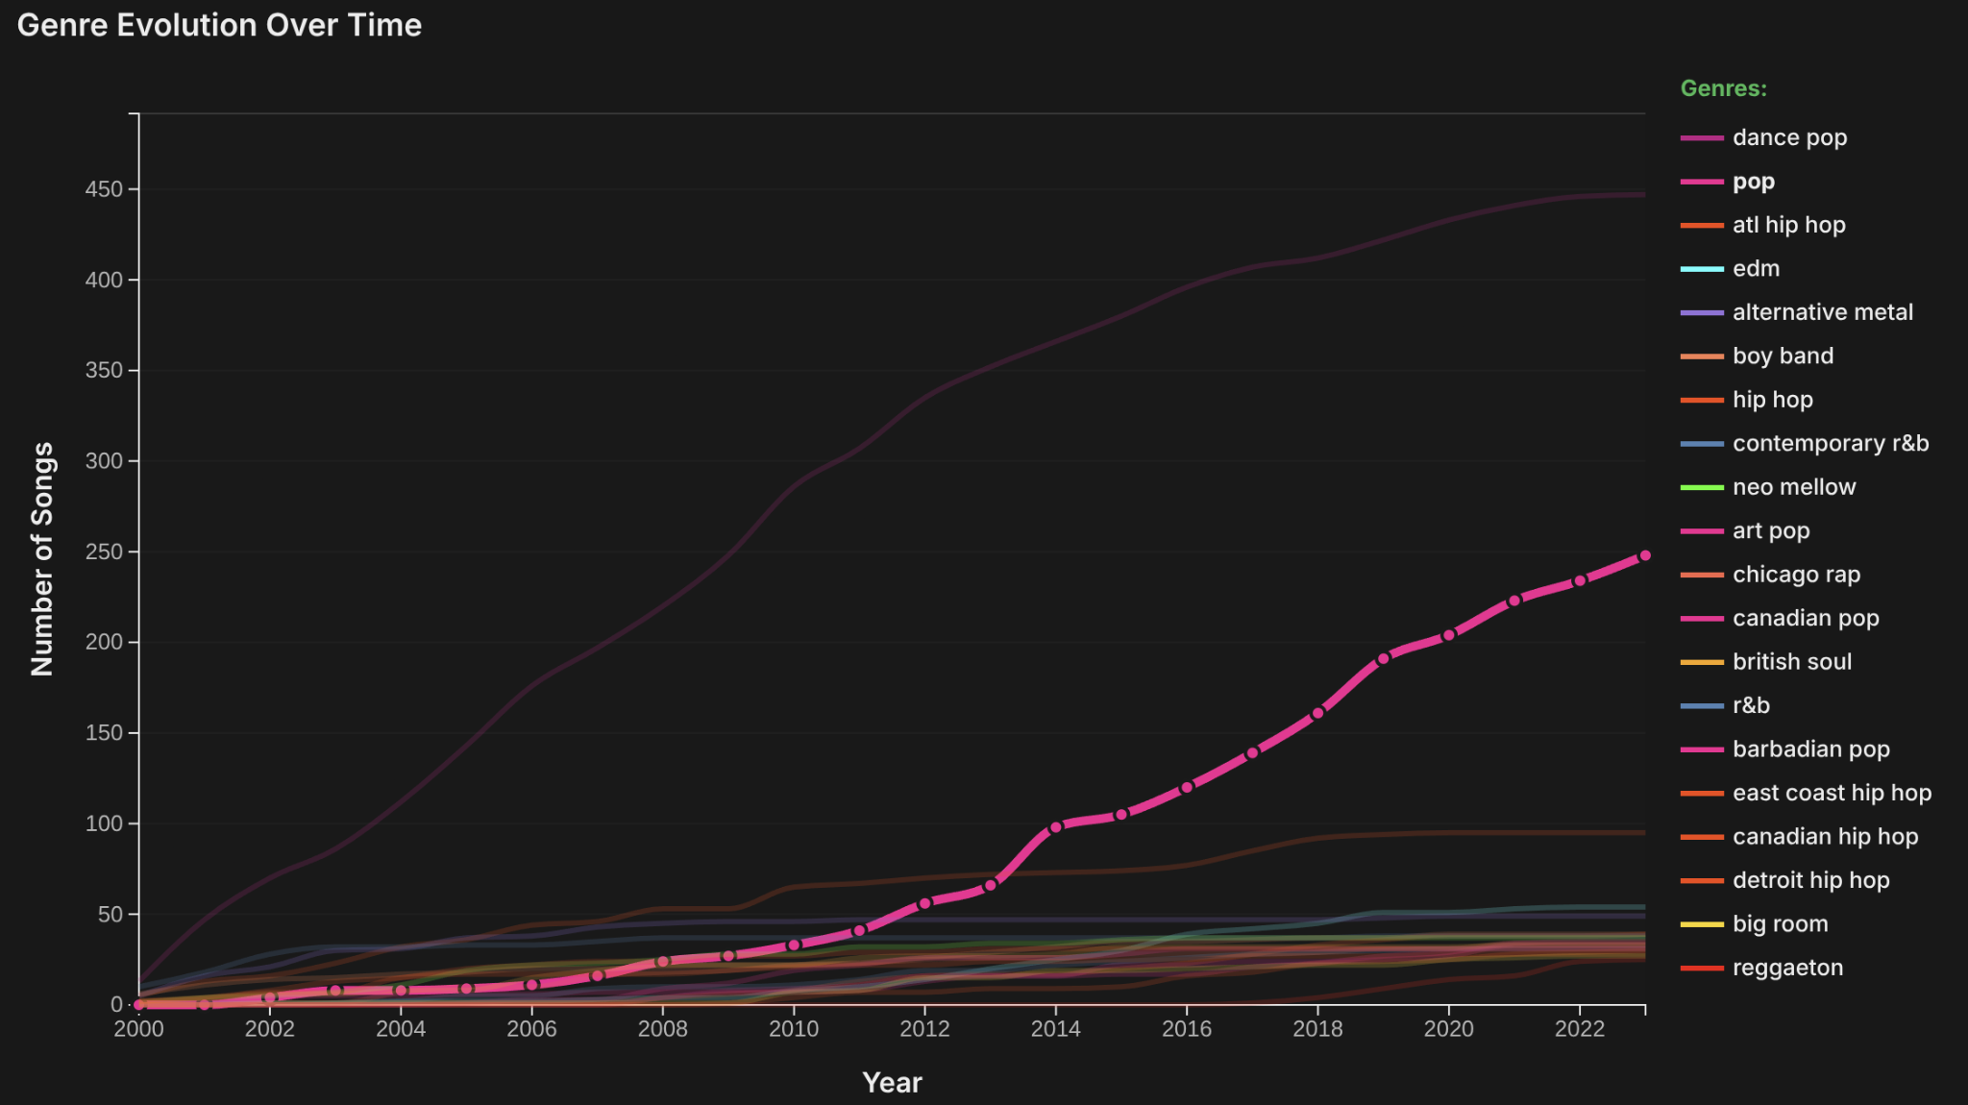
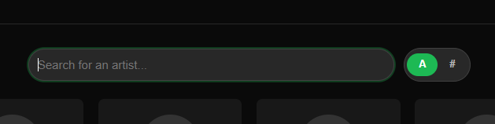
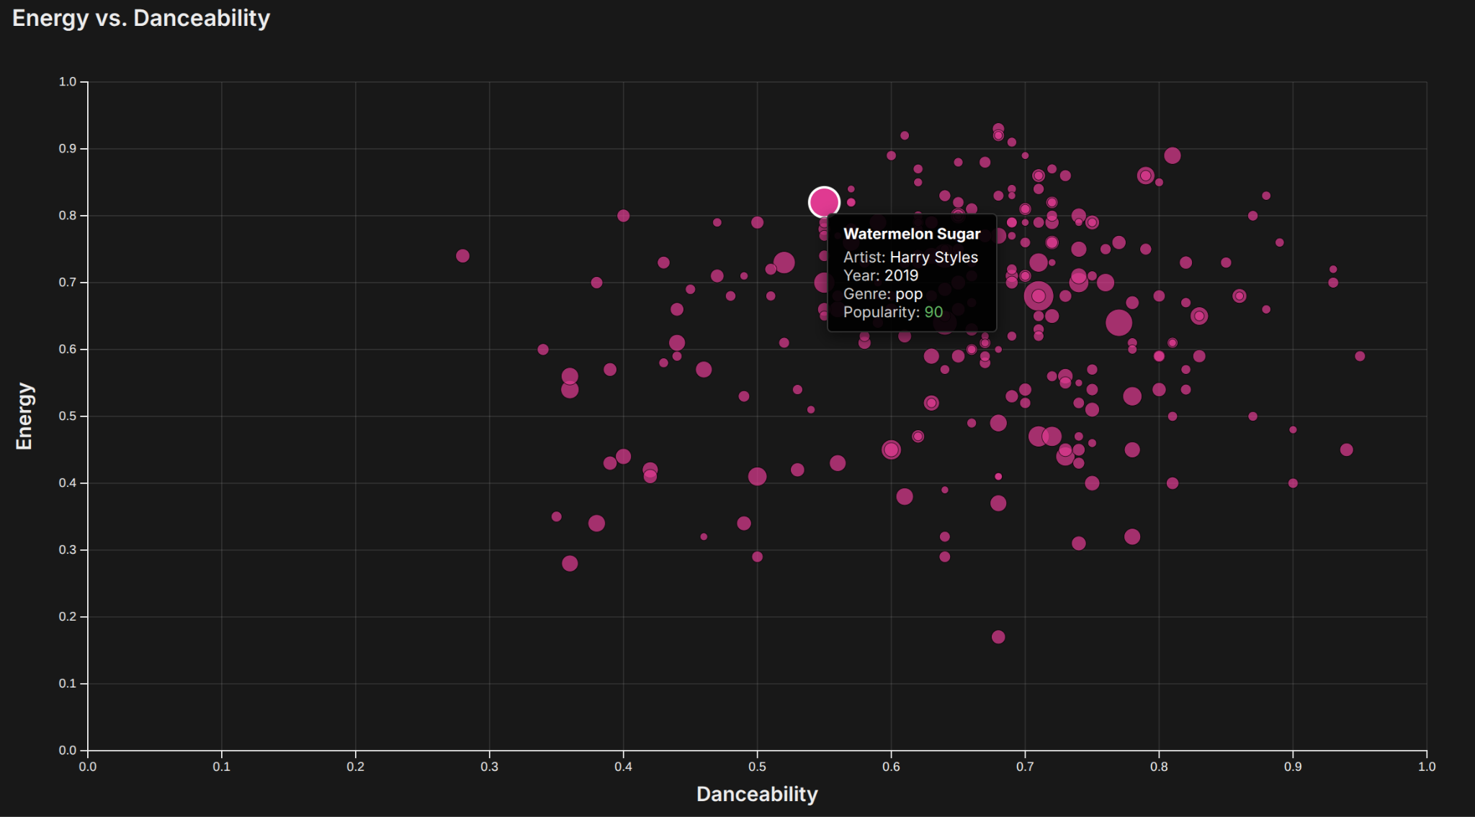
Interaction Mechanisms
Sidebar filters
Highlight on-hover
Search-bar
Details on-hover
5

Slide 6
Visualization Techniques
6

Slide 7
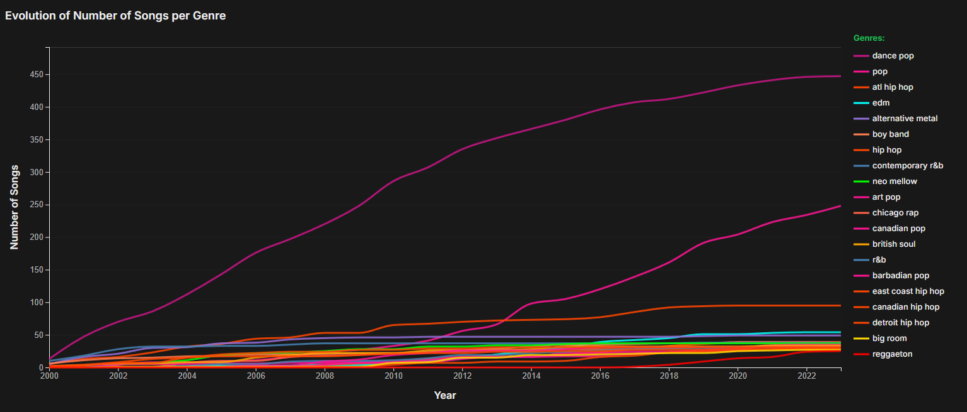
Line Chart
How have the different genres evolved from 2000 to 2023?
7

Slide 8
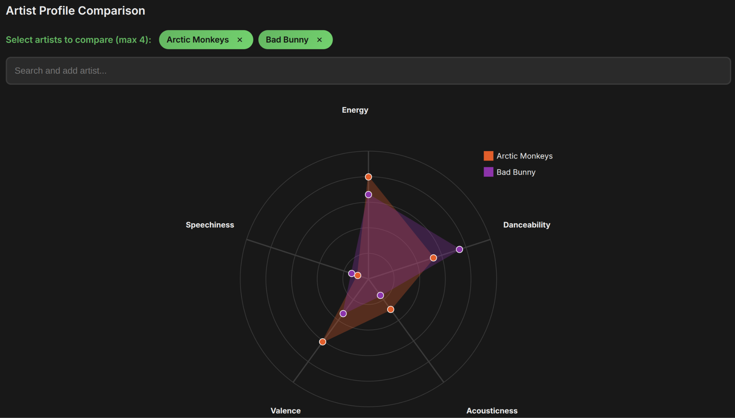
Radar Chart
What are the distinct audio characteristic profiles for different artists?
8

Slide 9
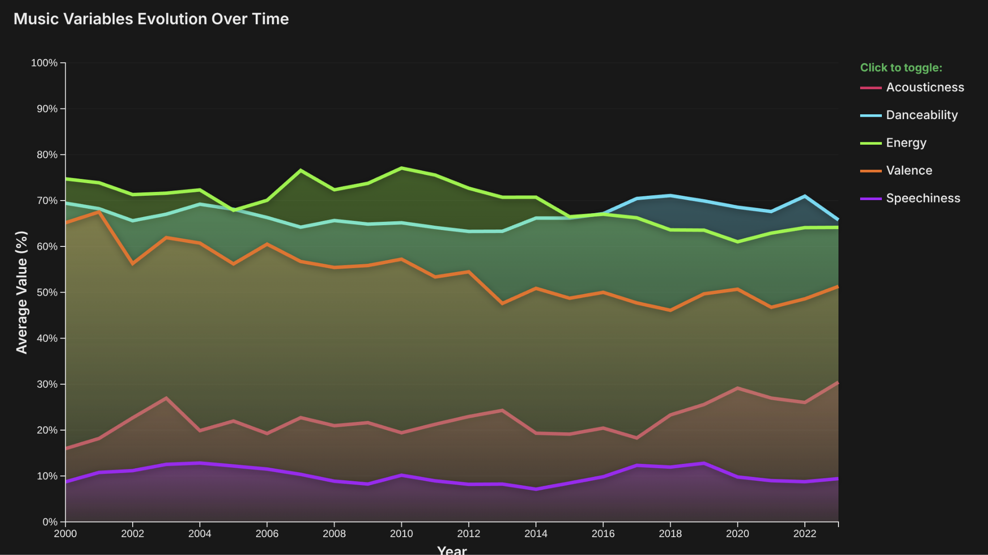
Line Chart
How have the overall audio characteristics changed over time?
Are songs becoming more energetic and danceable?
9

Slide 10
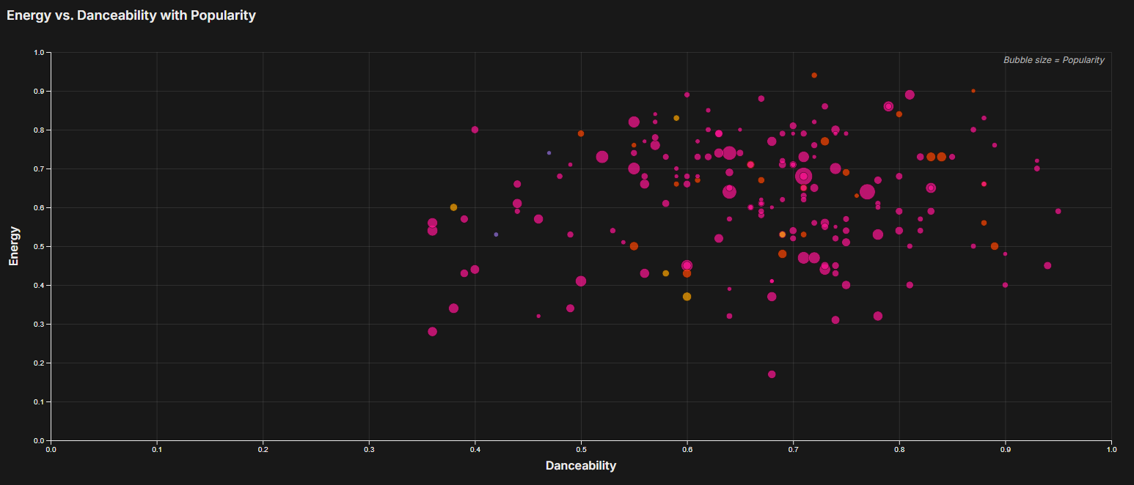
Scatter Plot
How do energy and danceability correlate with song popularity?
10

Slide 11
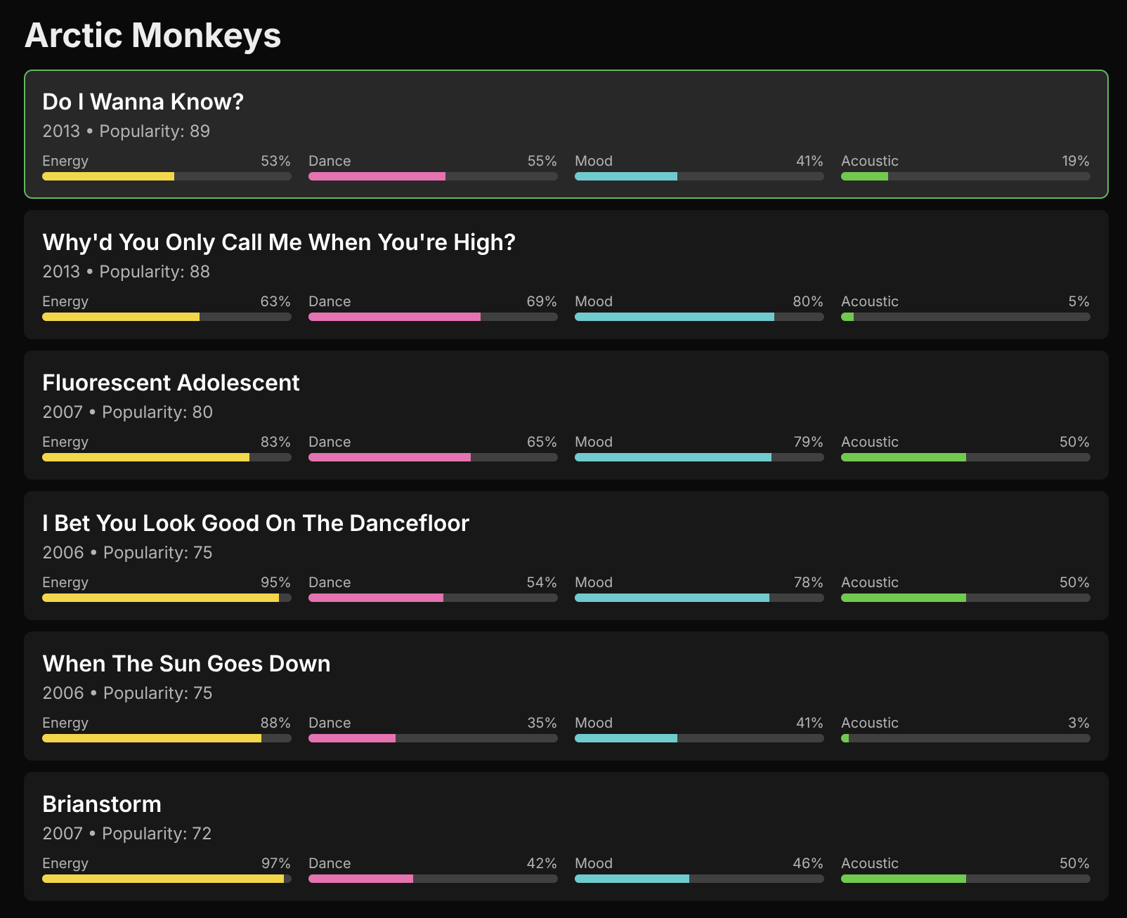
Hierarchical Drill-Down
How do the audio characteristics of a specific artist evolve across their discography?
11

Slide 12
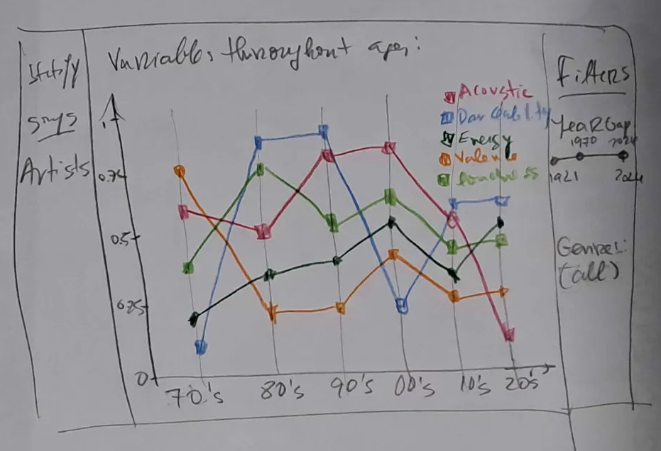
Usability Tests - LFP
In the initial phase of the project we did paper prototypes to test the visualization techniques.
12

Slide 13
Usability Tests
5 participants: 4M, 1F, all aged between 20-23
Goal
Evaluate how easily users navigate and understand the application.
Process
5 min free exploration of the app’s main features.
Task-based questionnaire
System Usability Scale Post-Task Questionnaire
13

Slide 14
Usability Tests - Tasks
5 participants: 4M, 1F, all aged between 20-23
Task 1: What is the most energetic song?
Task 2: What is the most popular song from 2016?
Task 3: What is the most popular song in the “neo mellow” genre?
Task 4: Which two genres have the most songs in 2014?
Task 5: How many songs from the genre “big room” were there in 2014?
Task 6: What was the trend in “energy” for songs in general between 2010 and 2016?
Task 7: What was the trend in “acousticness” for the genre “hip hop” between 2005 and 2010?
Task 8: Who has lower speechiness: Beyoncé or Taylor Swift?
Task 9: What is Taylor Swift’s most popular song?
Task 10: How energetic is the least popular Red Hot Chili Peppers song?
Task 11: How many songs does the band Fall Out Boy have?
14

Slide 15
Usability Tests - Results
5 participants: 4M, 1F, all aged between 20-23
Problems
Filters were not intuitive
Genres evolution graph was not showing data when only one year was selected
Artists were not showing when a genre was selected
Popularity on size on first graph was not intuitive
All these issues were resolved, leading to a smoother and more intuitive user experience
15

Slide 16
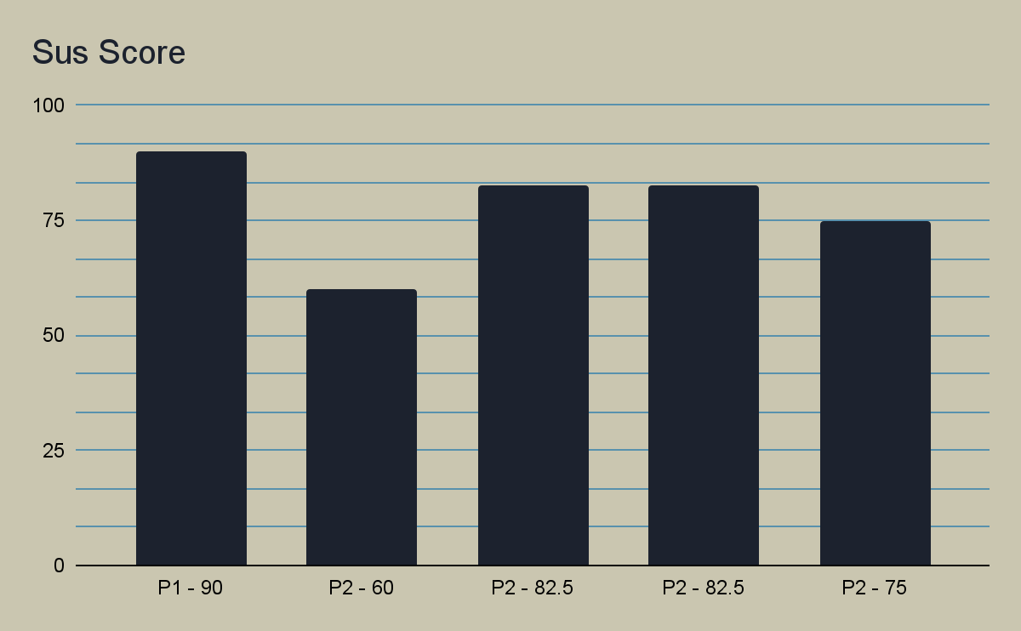
Usability Tests - SUS Scores
5 participants: 4M, 1F, all aged between 20-23
Average: 78
16

Slide 17
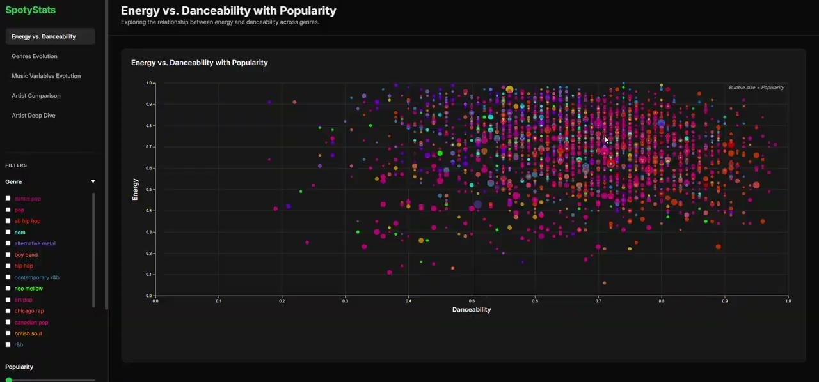
Demo
17

Slide 18
Conclusion
18

Slide 19
Thanks for your attention!
Any questions?
Information Visualization - 2025/2026
João Sousa - 103415
António Alberto - 114622
19

